Slide 1

Dynamic Fees for Automated Market Making
AFP 2024 Group 13

Slide 2
Outline
Automated Market Making in De-Fi
LVR & Data Preprocessing
Dynamic Fees Model
Single-Factor Model
Multi-Factor Model
Results & Conclusion

Slide 3
Market Making in Traditional Finance
Market Making - Providing liquidity by continuously offering to buy and sell securities.
Importance - Narrowing bid-ask spreads, enhancing market depth and stability.
Strategies - Limit orders, managing inventory, maintaining balanced books.
Regulation - Market makers operate in regulated environments overseen by financial regulatory bodies.

Slide 4
Transition to Decentralized Finance (DeFi)
Challenges of traditional financial markets:
Inefficiencies
Restricted access
Opaque operations
DeFi's solution:
Leverages blockchain technology to eliminate intermediaries, offering financial services directly on the blockchain.
Benefits of DeFi:
Democratized access
Greater transparency
Control over assets

Slide 5
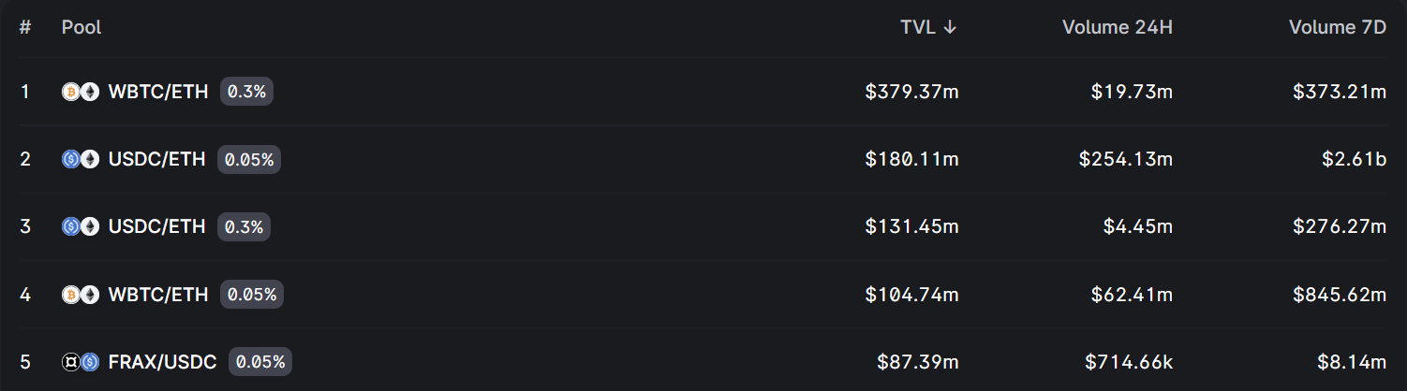
Automated Market Maker - Uniswap
No order books – Deterministic formulas for prices instead.
Inserts Liquidity Pools:
Uniswap hosts a diverse array of approximately 60 asset pairs. Amongst them, a notable 80% of the total liquidity is concentrated in a select group of 5 pairs featuring widely-traded tokens, such as ETH/USDC.

Slide 6
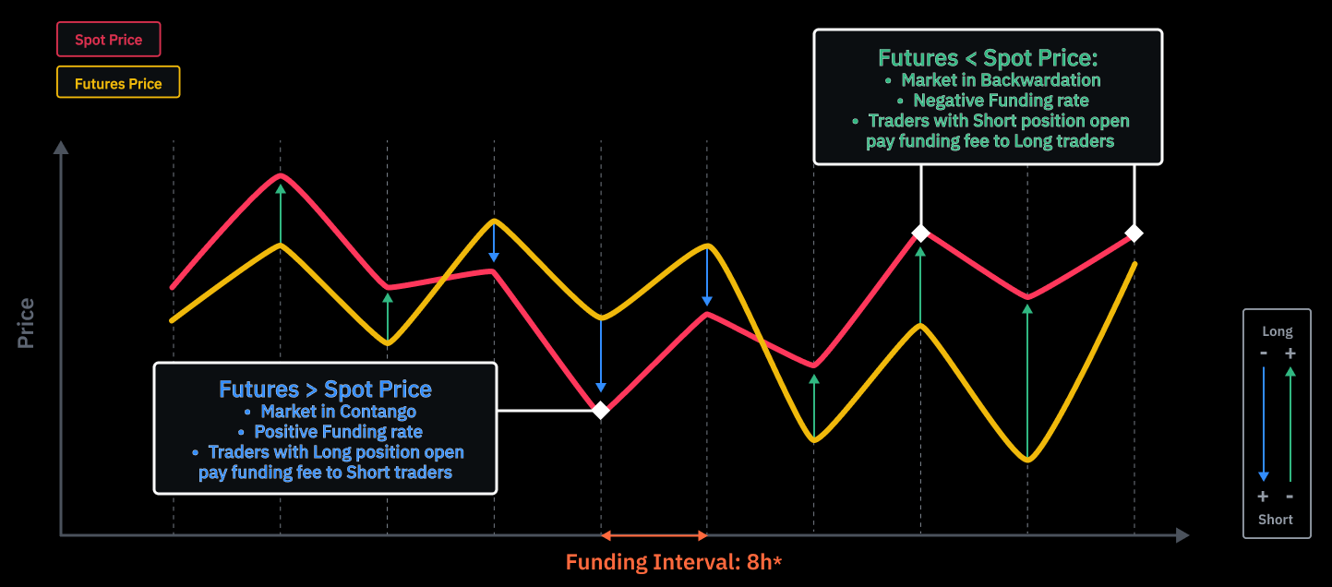
Funding Rate: Perpetual Future Contract vs Spot Trading
Funding Rate is the periodic 8h rate (could be positive or negative) determined by the difference between futures prices and spot prices.
Premium Index (P) = [Max (0, Impact Bid Price − Index Price) − Max (0, Index Price − Impact Ask Price)]/Index Price

Slide 7
Assumptions
CEX depth
Static single DEX pool.
Ideal theoretical arbitrage profits (no other pool or triangular arb)
No CEX fees.
Single LP behavior
ETH Gas Fee auction simplification. Take gas fee as endogenous parameter
No MEV / block tx ordering consideration
Difficulties of the simulation (joint process of price difference and

Slide 8
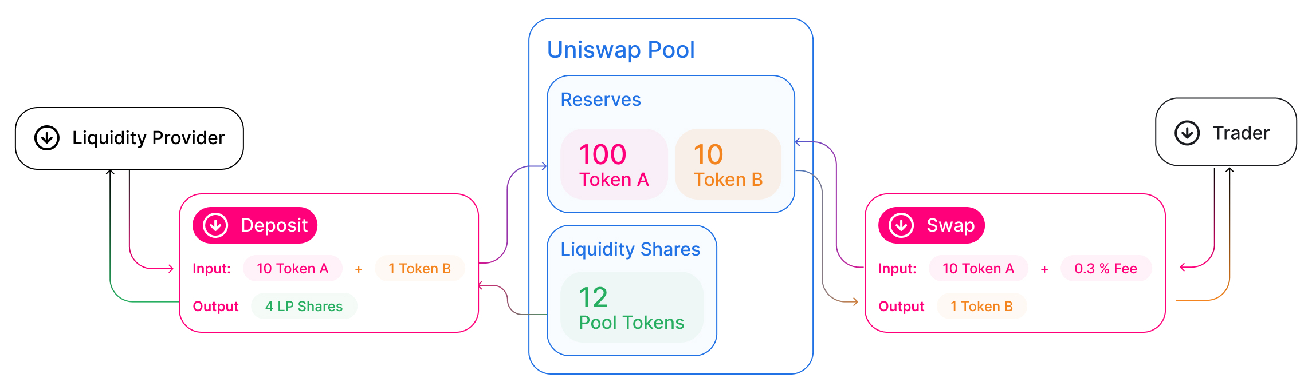
Uniswap Mechanism
Liquidity providers (LPs) deposits two assets to the pool, in exchange of LP shares.
Traders are charged a 0.3% fee every time it executes a swap.
This fee charged to the trader is then distributed among LPs.

Slide 9
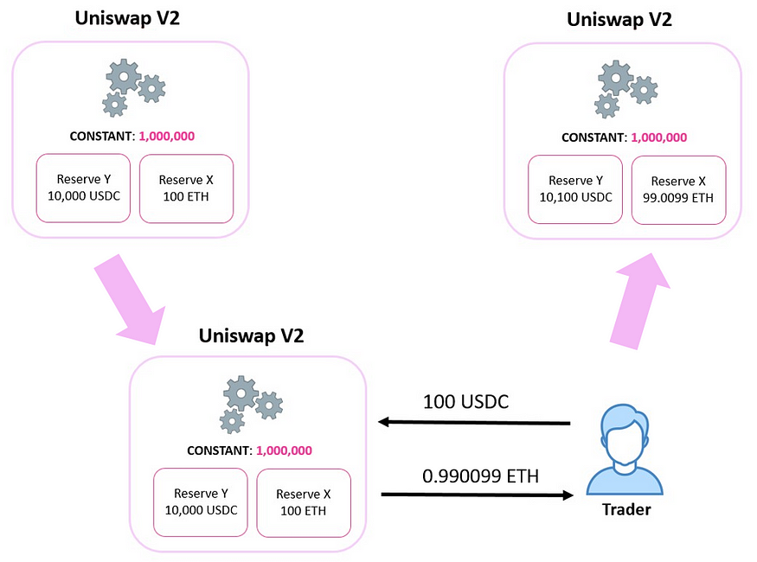
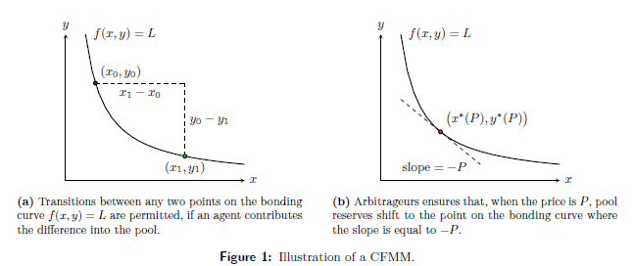

Uniswap Mechanism contd.
Constant Function Market Maker:
$$L= \sqrt{x∙y}= \sqrt{(x+∆x)(y+∆y)}$$

Slide 10
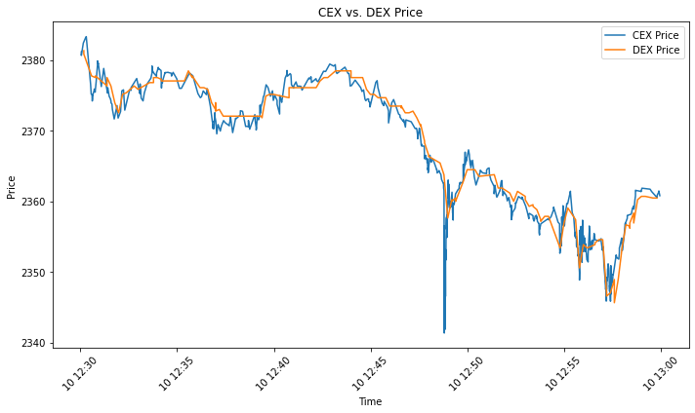
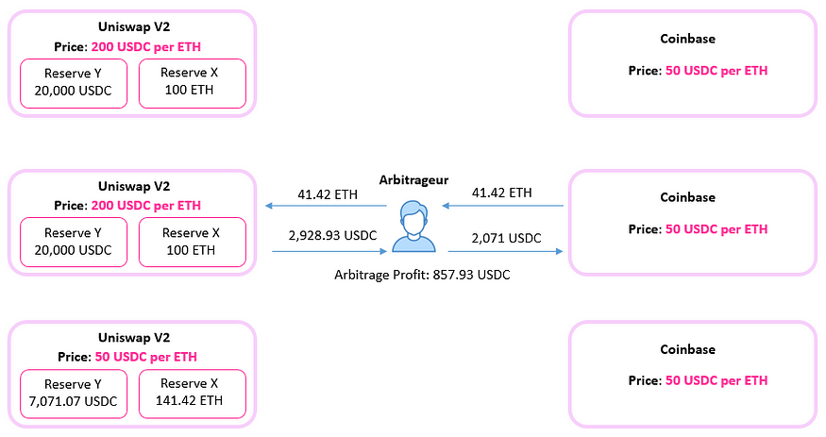
CEX-DEX Arbitrage
Price discrepancies, opportunities for arbitrageurs:
CEX is more liquid (add 24h traded volume here)
DEX has stale prices
Flash Loans (borrowing funds wo collateral), Mempool Tx replacement, Batching.

Slide 11
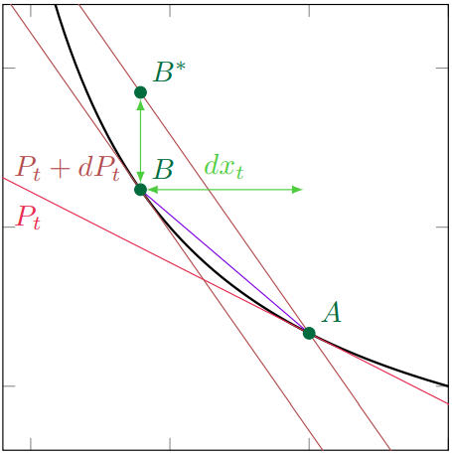

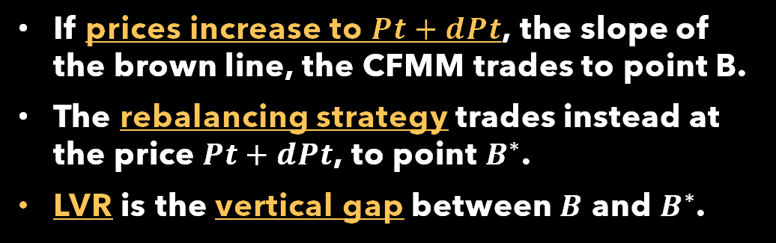
Loss-Versus-Rebalancing (LVR)
The LVR phenomenon encapsulates the risk incurred by LPs due to the exploitation of stale prices in DEXs by arbitrageurs, leading to suboptimal outcomes for liquidity provision.
If prices increase to $Pt+dPt$, the slope of the brown line, the CFMM trades to point B.
The rebalancing strategy trades instead at the price $Pt+dPt$, to point $B^{∗}$.
LVR is the vertical gap between $B$ and $B^{∗}$.
LVR and CFMM LP Price Slippage

Slide 12
Study Objectives
Ensure Fairness While Improving Market Efficiency
By developing a nuanced understanding of the underlying economics of AMMs, particularly from the perspective of LPs, we seek to devise innovative solutions that mitigate the adverse effects of LVR and promote a more equitable and efficient marketplace.
Democratize Financial Services And Foster Inclusive Participation
Through our research efforts, we aspire to pave the way for a more resilient and equitable decentralized financial infrastructure that empowers individuals and communities worldwide

Slide 13
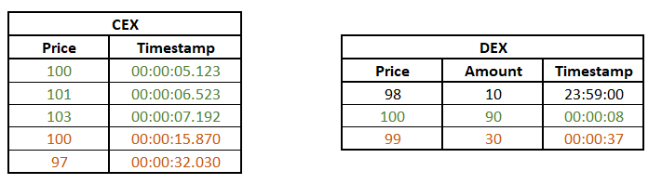

Data preparation
DEX Data: WETH-USDC pool on Uniswap V3
CEX Data: ETH-USDC transactions on Binance
Time Period – January 1, 2024 – January 31, 2024

Slide 14
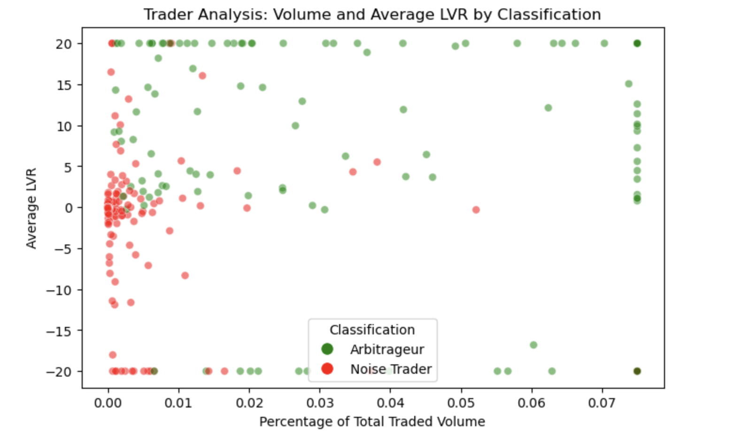
Arbitrageurs and Noise Traders
Arbitrageurs: traders who capitalize on price differences across decentralized and centralized exchanges to secure profits.
Noise Traders: participants who engage in transactions within the AMM pools for idiosyncratic reasons.

Slide 15

Single-factor Fee Model
In this study, we designed a dynamic fee model that depends exclusively on the ∆p observed between CEX and DEX prices. More specifically, on the z-score of the observed ∆p. In general, the model follows the following equations:
$$f_{buy} = min(max(f_{min}, ω∙Z(∆p) − s),f_{max})$$
$$f_{buy}= min(max(f_{min},−ω∙Z(∆p) − s), f_{max})$$
where,
$∆p = p_{cex}− p_{dex}$
$Z(∆pi) = ∆pi−µ σ$
µ, the average ∆p on the calibration period
σ, the standard deviation on the calibration period •
$f_{min}$ and $f_{max}$, the lower and upper bound of buying and selling fees
ω, parameter for weight attached to $∆p$ in the calculation of fees
s, parameter for deviation from the hypothetical max fee

Slide 16
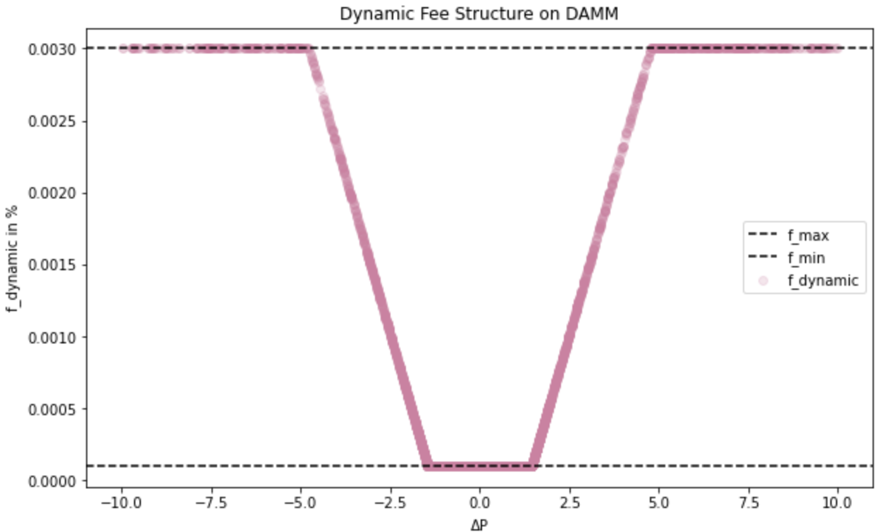
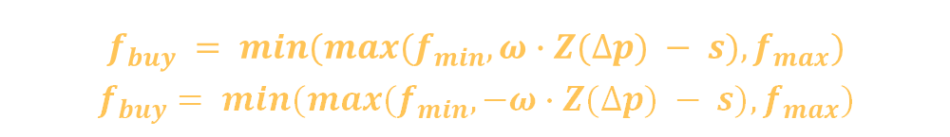
Dynamic Fee Structure on DAMM
$$f_{buy} = min(max(f_{min}, ω∙Z(∆p) − s),f_{max})$$
$$f_{buy}= min(max(f_{min},−ω∙Z(∆p) − s), f_{max})$$
Adjust Fee Based On Order Direction. This plots shows a combination of both $f_{buy}$ and $f_{sell}$, which are symmetrical on x = 0.

Slide 17
Model Calibration
Our objective is to establish a dynamic fee structure, which adjusts linearly based on the price disparity.
Data Winsorization. The training dataset -> positive PnL, concentrates on transactions where Z(∆P) ∈ [−10, 10].
Regression. OLS to regress winsorized PnL on Z(∆P) to find the linear dynamic fee’s gradient ω.
Parameter Optimization. The shift parameter s% is calibrated by maximizing the dyamic fee, with the constraint that trading volume must stay above a certain threshold.
Fee Structure. Use the ω and shift s% to calibrate the straddle shape fee structure.
Data Fitting. Use the above fee structure to fit all the transactions from January 2024.

Slide 18
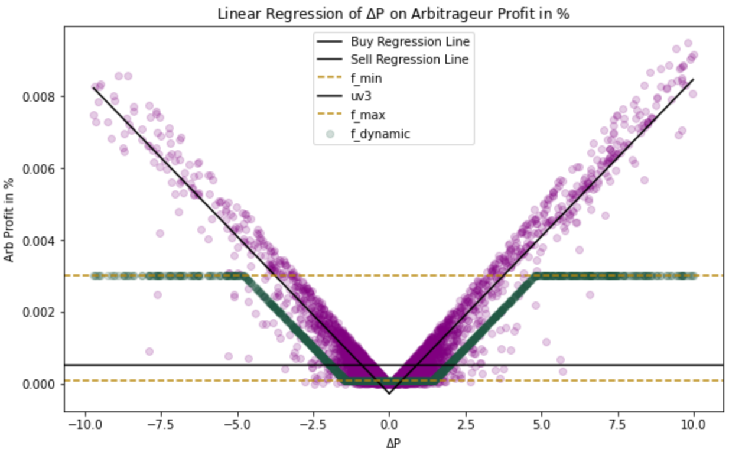
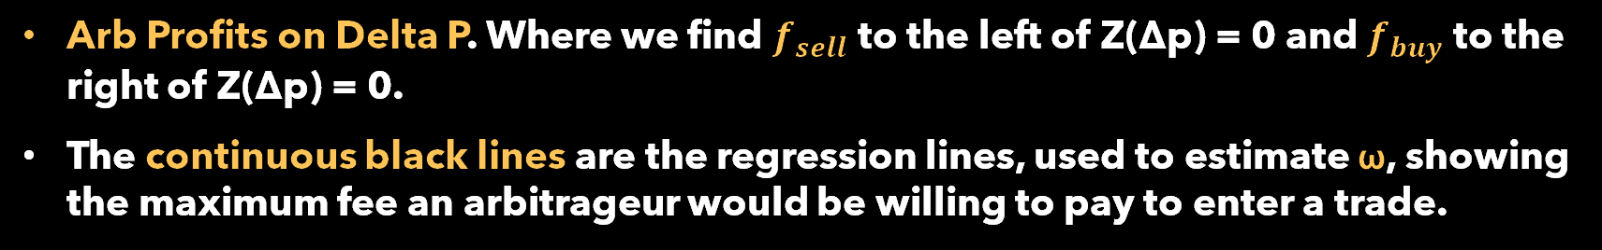
Calibration Result
Arbitrage Profits
shift
Proposed Dynamic Fee
Arb Profits on Delta P. Where we find $f_{sell}$ to the left of Z(∆p) = 0 and $f_{buy}$ to the right of Z(∆p) = 0.
The continuous black lines are the regression lines, used to estimate ω, showing the maximum fee an arbitrageur would be willing to pay to enter a trade.

Slide 19
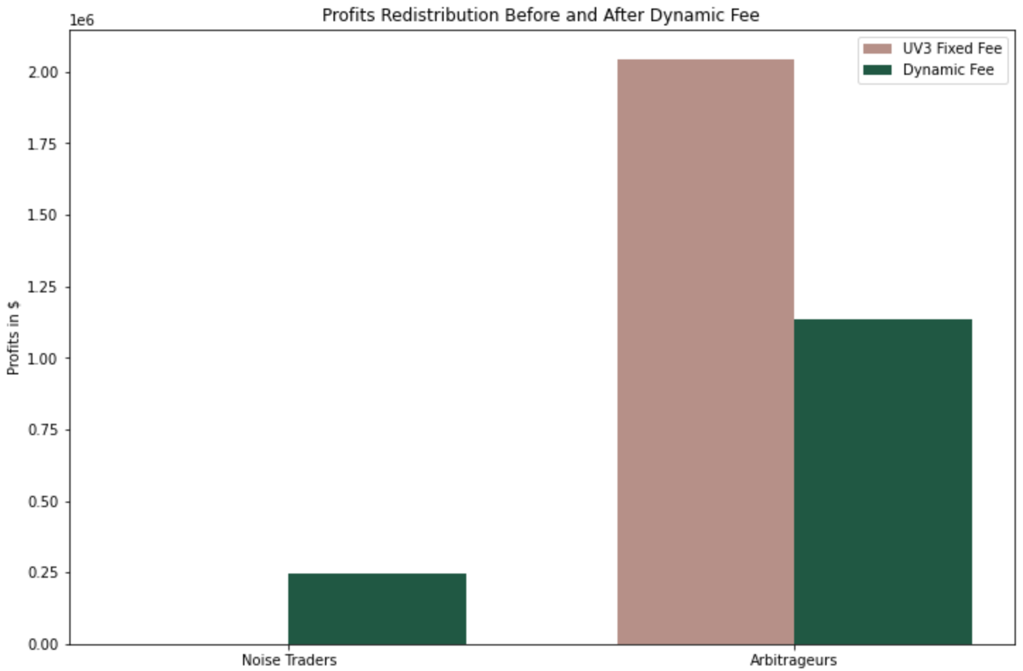
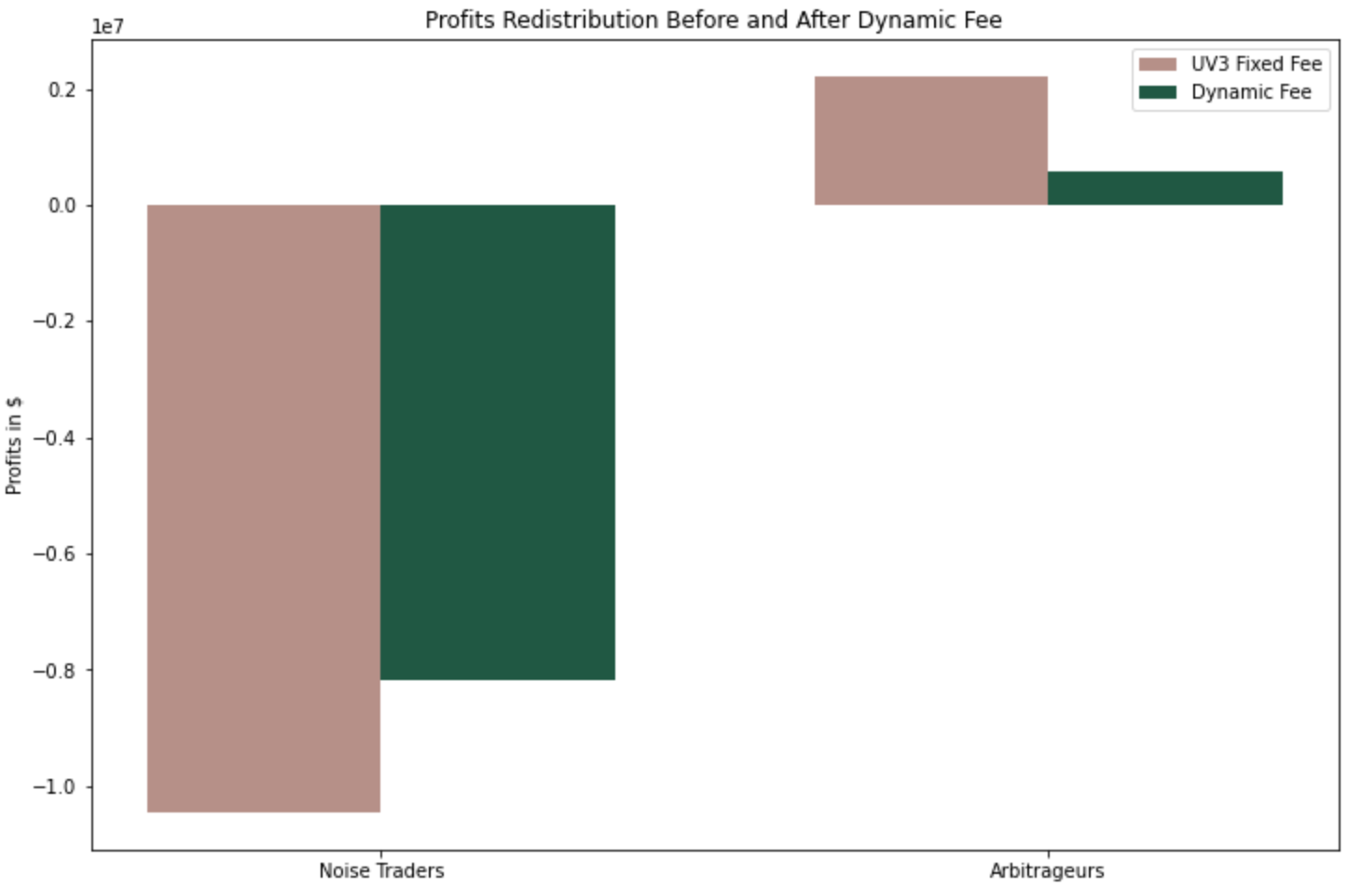
Model Empirical Analysis
Profit Redistribution Before and After Dynamic Fee
UV3 Fixed Fee
UV3 Fixed Fee
Dynamic Fee
Dynamic Fee
Noise Traders
Arbitrageurs
Noise Traders
Arbitrageurs
Overall, 98% of the trades are charged less than the Uniswap V3 proxy 5 bps.
3.645% of the transactions are classified as arbitrageur trades.

Slide 20
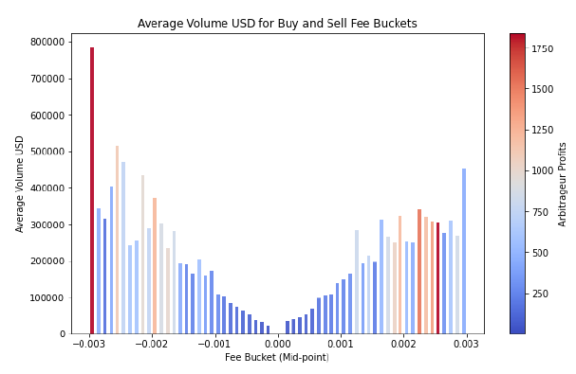
Model Empirical Analysis
Higher fee buckets corresponds to higher profits, which ensures that the dynamic fee model punishes arbitrageurs with higher profits while lowering the cost for others

Slide 21

Multi-factor Fee Model
The fees are determined by the following equation:
$$f_{buy/sell}= \sum_{i=1}^{n}{min\left(max\left(f_{min},{\text{ω}}_{i}f_{i}\left(g_{i}\right)\right), f_{max}\right)} f_{i}(g_{i}) ∝m_{i}g_{i}$$
where,
$f_{min}$ and $f_{max}$, the lower and upper bound of buying and selling fees for each independent feature
$g_{i}$, factors like the price difference (∆p), arbitrageurs PnL from the arbitrage (PnL), rolling price volatility from the last 100 datapoints ($σ_{100}$), price impact (PI), among others
$f_{i}$, linear function with slope mi mapping a specific factor i to a fee $f_{i}$
${\text{ω}}_{i}$, the parameter which determines the weight attached to the factor-individual fees $f_{i}$

Slide 22

Model Calibration
Data Segmentation. The dataset is initially segmented into two subsets based on the direction of the transaction—purchases (buy) and sales (sell).
Feature-Based Quantile Scaling. For each relevant feature in the dataset (e.g., price difference, transaction volume, etc.), quantile-based scaling boundaries are established.
Selecting $g_{i, max/min}$. Within each transaction subset (buy and sell) and for a given feature, max and min thresholds are calculated for the given feature using quantiles.
Setting $f_{min}$ and $f_{max}$. We give fixed values for these across all features, with $f_{min}$ = 0.01 and $f_{max}$ = 0.1.
Estimating the Fee per Feature fi. we find the slope of the line to fit the fees to, mi by simply taking $\frac{f_{max} \text{−} f_{min}}{g_{max} \text{−} g_{min}}$.

Slide 23
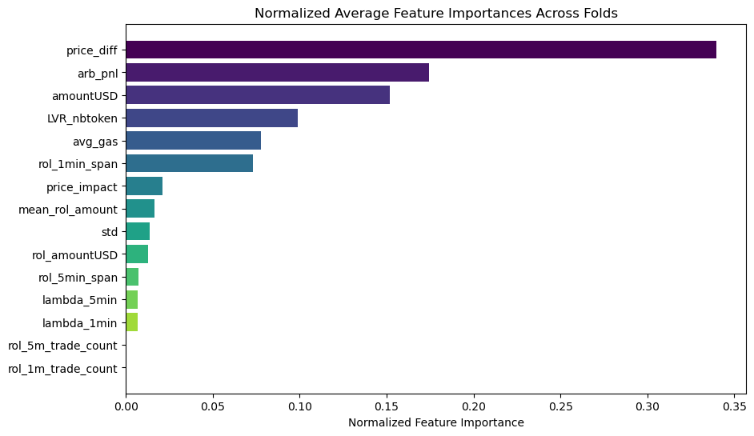
Random Forest Features Importance
We ran a Random Forest Regression model over the features, having the hypothetical
fee (i.e. the maximum % profit an arbitrageur could make on a trade) as target variable
to get the feature importance.

Slide 24
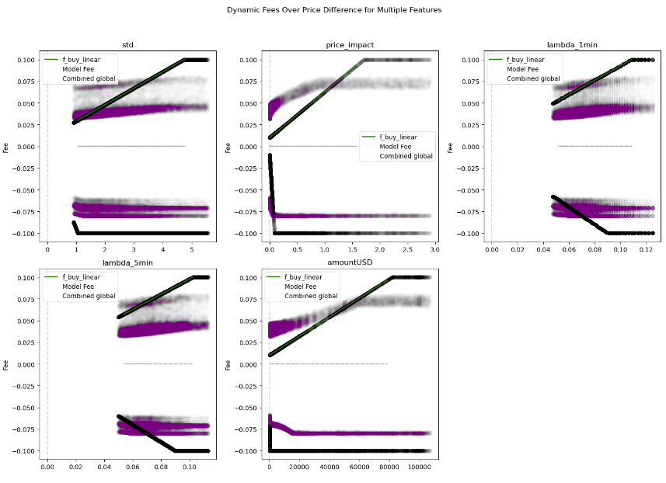
5-factor Model Result

Slide 25
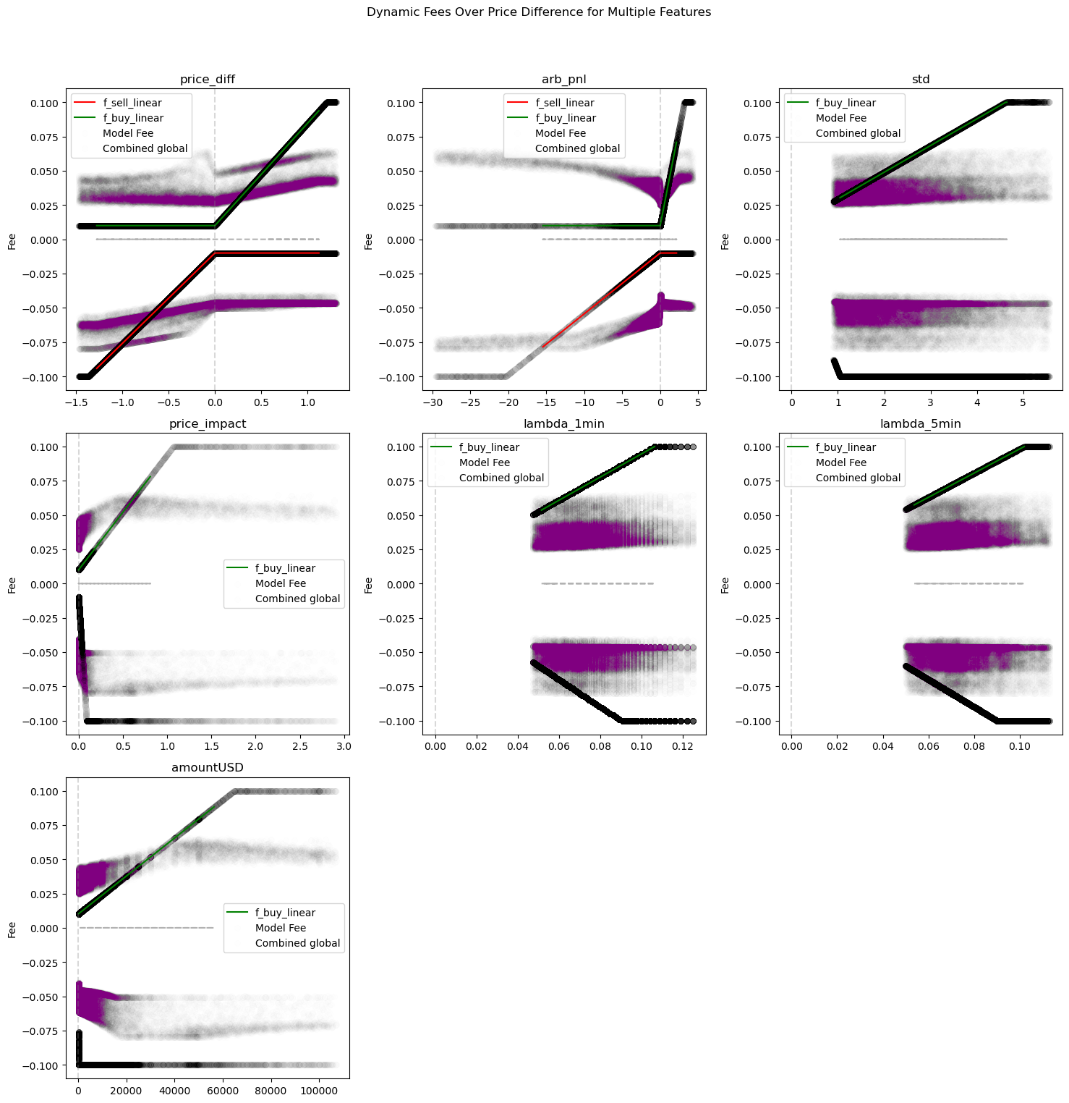
7-factor Model Result

Slide 26
Models Benchmarks
 | Constant Fee Model | 5 Factors Model (TradeFi Factors) | 7 Factors Model (DeFi Factors) | 10 Factors Model
Percent of additional profits of the dynamic fee over the constant fee model | 0.0 % | 0.0 % | 0.0 % | 0.05 %
Price impact percent improvement (decreased impact) of the dynamic fee model | 0.0 % | 0.0 % | 0.0 % | 0.05 %
Average dynamic selling fee (%) | -0.05 | -0.07 | -0.05 | -0.07
Average dynamic buying fee (%) | 0.05 | 0.05 | 0.04 | 0.05
Impermanent loss in % | -1 | -1 | -1 | -1
Average t-cost in $ |  | 93.06 | 47.31 | 38.77
Average on 1 min selling_fee | -0.05 | -0.05 | -0.03 | -0.04
Average on 1 min buying_fee | 0.05 | 0.02 | 0.02 | 0.02
Weighted average buying_fee ($) | 0.05 | 0.06 | 0.05 | 0.06
Weighted average selling_fee | -0.05 | -0.08 | -0.06 | -0.08
Accuracy of the fees (in the range of the constant fee trader will be willing to pay) | 100% | 7.53% | 9.86% | 4.2%

Slide 27
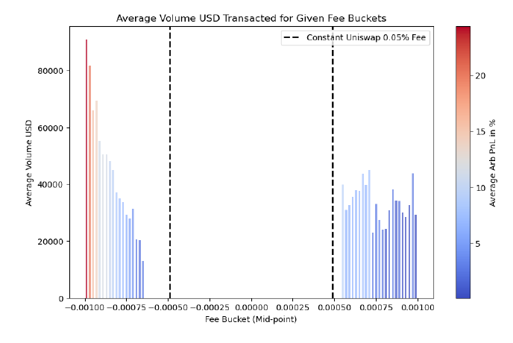
Model Empirical Analysis
Trades with higher profits are charged with higher fees, which aligns with the single factor model.
We punished arbitrageurs with higher profits, keeping the fee low for the rest of the users.

Slide 28
Limitations & Constraints
Reliance on CEX Prices:
Vulnerabilities: Exposed to Oracle Attacks, allowing malicious actors to manipulate transmitted data.
Adverse Effects: Potential for price manipulation, degradation of pool vitality, loss of trust, and impermanent loss exposures for LPs.
Operational Complexities:
Parameter Recalibrations: Necessity of frequent adjustments of parameters such as slope (ω) and shift (s%).
Derived from Empirical Data: Reflecting the dynamic nature of DEX, requiring alignment with current market conditions and periodic adjustments.

Slide 29
References
[1] David Cao, Brett Hemenway Falk, and Gerry Tsoukalas. Automated market makers and the value of adaptive fees. Available at SSRN, 2023.
[2] Darrell Duffie. Market making under the proposed volcker rule. Rock Center for Corporate Governance at Stanford University Working Paper, (106), 2012.
[3] Dan Robinson Haydem Adams, Noah Zinsmeister. Uniswap v2 core. Uniswap Whitepaper, 2020.
[4] Dan Robinson Moody Salem River Keefer Haydem Adams, Noah Zinsmeister. Uniswap v3 core. Uniswap Whitepaper, 2021.
[5] Albert S Kyle. Continuous auctions and insider trading. Econometrica: Journal of the Econometric Society, pages 1315–1335, 1985.
[6] Conor McMenamin, Vanesa Daza, and Bruno Mazorra. An automated market maker minimizing loss-versus-rebalancing, 2023.
[7] Jason Milionis, Ciamac C Moallemi, and Tim Roughgarden. Automated market making and arbitrage profits in the presence of fees. arXiv preprint arXiv:2305.14604, 2023.
[8] Jason Milionis, Ciamac C Moallemi, Tim Roughgarden, and Anthony Lee Zhang. Automated market making and loss-versus-rebalancing. arXiv preprint arXiv:2208.06046, 2022.
[9] Deepak Prashar et al. Analysis on blockchain vulnerabilities & attacks on wallet. In 2021 3rd international conference on advances in computing, communication control and networking (ICAC3N), pages 1515–1521. IEEE, 2021.

